Slide 1

József Györkös, Director
* * *
Ljubljana, May 22 2019

Slide 2



Slide 3

03. 09. 2015
Government of RS adopts the
National strategy on open
access 2015 - 2020
27. 05. 2017
Ministry of Education, Science and Sports adopts the Action Plan
18. 03. 2016
ARRS Public Call for Research
Projects for 2017 -
recommendation on compliance
with national strategy included
24. 08. 2018
ARRS Public Call for Research
Projects for 2019 -
recommendation on compliance
with national strategy strengthened
04. 09. 2018
Science Europe, European
Commission and ERC announce
#Plan_S
ARRS as a #cOAlitionS member
16. 06. 2017
ARRS Public Call for Research
Projects for 2018-
recommendation on compliance
with national strategy included
19. 10. 2018
Pilot Public call on financing APC costs for Gold Open Access published
27. 11. 2018
#Plan_S
Implementation Plan published
15. 02. 2019
Deadline for feedback
on #Plan_S Implementation Plan
– public consultation

Slide 4
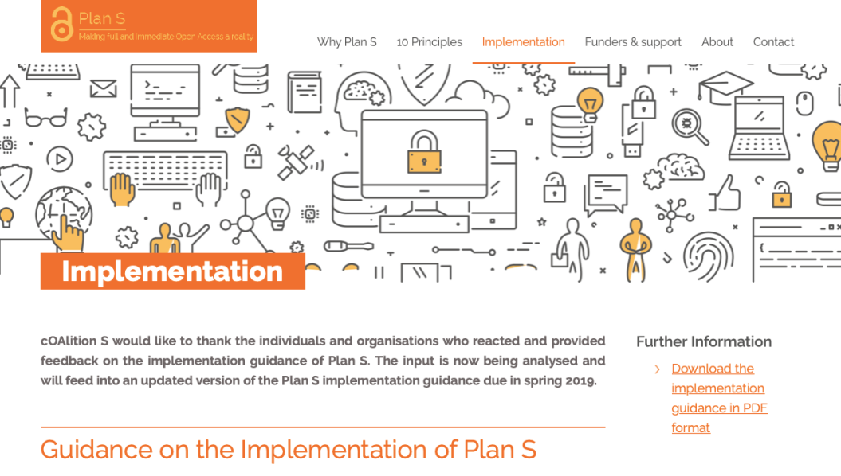
15. 02. 2019 – 15.05.2019
a #cOAlitionS Task Force analyisis of
600+ feedbacks;
Adopts revised #Plan_S and
Implementation Plan
September 2019
Second edition of the ARRS Pilot Public call on financing APC costs for Gold Open Access to be published
15. 5. 2019
Multi-stakeholder
Working Group established
ARRRS
31. 05. 2019
Public release of revised
#Plan_S
and
Implementation Plan
September/October 2019
Call for scientific literature
consortia
(announced)
https://www.coalition-s.org/implementation/

Slide 5
... and Open Access
Idea and principles of open access | Clear support.
Implementation:
Inclusive and well thought through in complementarity to standard procedures. | Multiannual processes; processes need to be defined timely, having legal base, financial volume and staff; the need to include related on-going activities, e.g. public call for scientific literature
Robust and inclusive infrastructural support needs to be established. | Are all stakeholders involved / have access to the infrastructure? Are their rights and obligations clearly defined?
Element of responsibility for implementation. | We have a well defined objective – do we have staff, other resources needed for the implementation? How rigorous sanction system do we need; how to change the award system to motivate for OA publishing (scientific excellence); how to further form a critical mass to negotiate with publishers (small community)?
Hic Rhodus, hic salta! | Valid for all stakeholders.

Slide 6

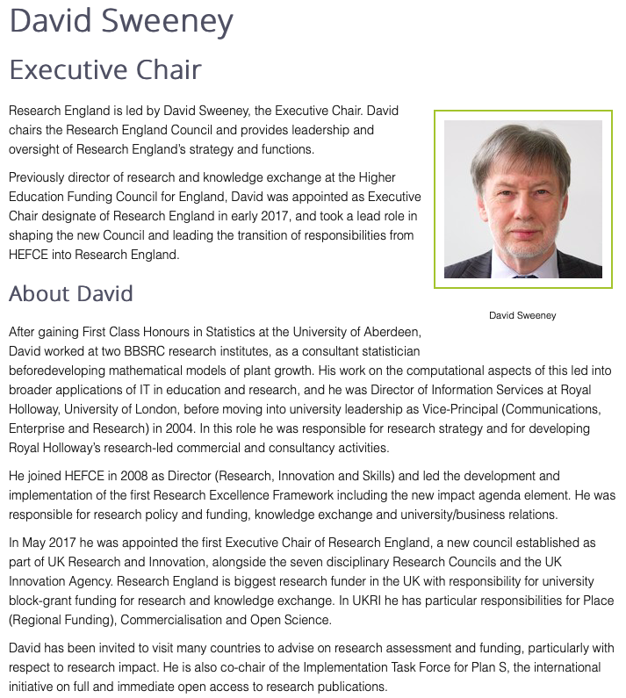

An implementation task force, lead by
John-Arne Røttingen (RCN) and David Sweeney (UKRI) …

