Slide 1
Open Science – European Commission policies and perspectives
Open Science Conference- University of Ljubljana- 22 May 2019
J.C Burgelman, R. Von Schomberg, J-F Dechamps, A. López de San Román, V. Tsoukala DG RTD Open Science Unit

Slide 2
What is Open Science?
Open Science is about
“sharing data and knowledge as early as possible in open collaboration with all relevant knowledge knowledge actors”
Open Science has therefore:
Open output dimension of research (Publications, Data, software etc.)
Open Input dimension of research (knowledge input by diverse set of actors, open data, preprints etc)
Source: Melanie Himming

Slide 3
Why is Open Science so important?
Open Science is expected to make Science:
More efficient (sharing resources)
More reliable (better, open verification)
More responsive to societal challenges/demands (more open inputs from variety of knowledge actors)

Slide 4
Eight policy priorities
Use and management of research results
1. FAIR data: FAIR data sharing is the default for funding scientific research
2. European Open Science Cloud: all EU researchers are able to deposit, access and analyse European scientific data through EOSC, without leaving their desk
3. Indicators: alternative metrics (next generation metrics) complement conventional indicators for research quality and impact (e.g. JIF and citations)
4. Future of scholarly communication: all peer reviewed scientific publications are freely accessible and early sharing of different kinds of research outputs is encouraged
Alignment of research partners
5. Rewards and incentives: the European research career evaluation system fully acknowledges Open Science activities
6. Research Integrity: all publicly funded research in the EU adheres to commonly agreed Open Science standards of research integrity
7. Skills and education: all scientists in Europe have the necessary skills and support to apply Open Science research routines and practices
8. Citizen Science: citizens significantly contribute and are recognised as valid knowledge producers of science
Pointer: Amsterdam Call for Action on OS (policy priorities identified from 12 action items)

Slide 5
Implementation of Open Science Agenda
3 years later (1)
OS Ambition | 2015 | 2016 | 2017 | 2018 | 2019 | 2020
Open Access Publications | EC has OA mandatory since 2014 (H2020) | Council adopts ambition OA default by 2020 |  | Plan S launched for immediate OA from 2020 | Launch ORE
Open Data |  |  | OD default under H2020 |  |  | OD default under HE, Mandatory DMP + FAIR
EOSC | EOSC adopted under Digital Agenda |  |  | EOSC launched under Austrian Presidency 2018 |  | EOSC should be governed by MS

Slide 6
Implementation Open Science Agenda (continued)
3 years later (2)
 | 2015 | 2016 | 2017 | 2018 | 2019 | 2020
Indicators for Open Science |  |  |  | OSPP endorses new generation metrics | Declaration on Indicators for Open Science
Citizen Science |  |  |  |  | Citizen Science as rewardable and fundable practice (Helsinki
OS Rewards |  |  |  | OSPP makes a priority of Rewards for OS | Embed OS in Modernisatio, Europeanisatioof Universities
Open Science Agenda (with all 8 ambitions) |  | Council welcomes Open Science Agenda and endorses establishment EOSC and welcome OSPP |  | Open Science Policy Platform delivers integrated advice on 8 ambitions |  | Council Conclusions on Open Science
Research Integrity | European Code of Conduct implemented under Grant Agreement H2020- OS not fully addressed.

Slide 7
Open Science Policy Platform
Key objective
Co-develop and co-implement Open Science policies (i.e. make mutually reinforcing steps among 25 Major Stakeholders at European level)
Main achievement
Advice on eight ambitions (May 2018)
Next
Second mandate (May 2016-May 2020) with focus on citizen science (good practices) and indicators (implementation plan) as also a basis for rewards/incentives
Pointer: Open Science Policy Platform web page

Slide 8
1. FAIR data
Key objective
Implement FAIR data in EOSC, and beyond
Main achievements
FAIR embedded in several ‘EOSC documents’: Communication (2016), Declaration (2017), Council Conclusions (2018)
Study (June 2018) with cost-benefit analysis
EC FAIR data Expert Group report (November 2018)
Next
Collaboration with EOSC Working Groups
FAIR-compliant certification scheme for data infrastructures and policy on Persistent Unique Identifiers in EOSC (end 2019)
Horizon 2020 project-funding

Slide 9
2. European Open Science Cloud
Key objective
Adapt research infrastructures for Open Science and develop a common, federated, European framework (ecosystem) for publicly-funded research data
Main achievements
Implementation roadmap and launch (March & November 2018)
Two Expert Group reports (FAIR & EOSC in practice)
Next
Implementation including FAIR certification schemes for repositories, FAIRsFAIR project etc.
Mapping of EOSC-relevant national initiatives (end 2019)
Evaluation by EC and EU Member States (end 2020)
Pointer: EOSC web page

Slide 10
3. Indicators
Key objective
Develop and employ, for the development of Open Science, non-traditional metrics that cover not just citation of articles (i.e. what was initially named ‘Altmetrics’)
Main achievements
Report from the first Expert Group on Altmetrics (2017)
Second Expert Group on indicators for researcher’s engagement with Open science and its impacts (2018)
Next
Report on way forward to implement indicators for supporting/rewarding open science practices- pave the way towards new open science agenda post 2020
Pointer: Expert Group on Indicators web page

Slide 11
4. Open access
Key objective
Work with all stakeholders and EU Member States for the alignment of OA policies and support implementation in H2020
Main achievements
Revision of the Recommendation on Scientific Information, Public Sector Information Directive and EU Copyright Directive (2018)
EC Expert Group on the future of scholarly communication report (January 2019)
Next
Follow-up on legal and regulatory aspects (incl. Plan S)
Second tender on open access publishing platform (spring 2019)
Procurements (monitoring of and support to H2020) and reports
Pointer: Open Access web page

Slide 12
5. Rewards and skills
Key objectives
Encourage, support and incentivise researchers to practice Open Science, with a focus on both research performing and research funding organisations
Main achievement
Final reports of Expert Groups on Rewards and Skills
OSPP makes rewards for Open Science a priority
Next
Follow-up, in particular embed rewards for Open Science in the modernisation of European universities

Slide 13
6. Research integrity
Key objectives
Set European standards to foster research integrity in the development of Open Science, in particular having in mind the relation between science and society
Main achievement
Mutual learning exercise on research integrity (led by EU MS)
Support to the European Network on Ethics and Research Integrity, and European Network of Research Integrity Officers
Horizon 2020 project-funding
Next
Fully address Open Science in the European Code of Conduct with the aim of a full implementation in the Framework Programmes

Slide 14
7. Citizen Science
Key objective
Citizens significantly contribute and are recognised as valid knowledge producers of European science (part of dimensions supported by Responsible Research and Innovation)
Main achievement
OSPP report on citizen science (incl. recommendations)
Horizon 2020 project-funding
Next
Reports on good practices in citizen science to be produced in 2019 to inform development of two citizen science toolkits
Conference on citizen science towards the sustainable development goals (Berlin, second half of 2019)
Systemic approach in Horizon Europe

Slide 15
Open Science Monitor
Key objective
Get some quantitative and qualitative insights on the ongoing development of open science practices (this is not an assessment tool)
Main achievement
Two public procurement contracts launched and implemented in a sequential way, with a web-based demonstration in place
Next
Monthly updates till the end of 2019
Improvement of the Monitor once the EU has a more open and transparent data infrastructure for publicly funded research (notably with a full implementation of the EOSC)
Pointer: Open Science Monitor web page

Slide 16
Work with G7
Key objective
Share expertise, exchange best practices and develop synergies with the G7 Open Science Working Group
Main achievement
Several reports and updates
New focus on enhancing policies and initiatives for a global open science environment (two pillars: Public Access and Infrastructure)
Next
Workshop (Paris, June 2019)
Finalisation of various reports and presentation, in particular at G7 Science Sherpas in 2020 and next G7 Science and Technology Ministers’ Meeting (2020 or 2021)

Slide 17
Collaboration with OECD
Key objectives
Develop a set of general principles for enhanced access to and sharing of data, in particular a proposal on interoperable data platforms (LODES) and revision of the OECD Recommendation, and Principles and Guidelines for Access to Research Data from Public Funding (2007)
Main achievement
Participation in various talks and meetings
Next
Monitoring on the development of the LODES project
Consider joining the Steering Group on the enhanced access to data project

Slide 18
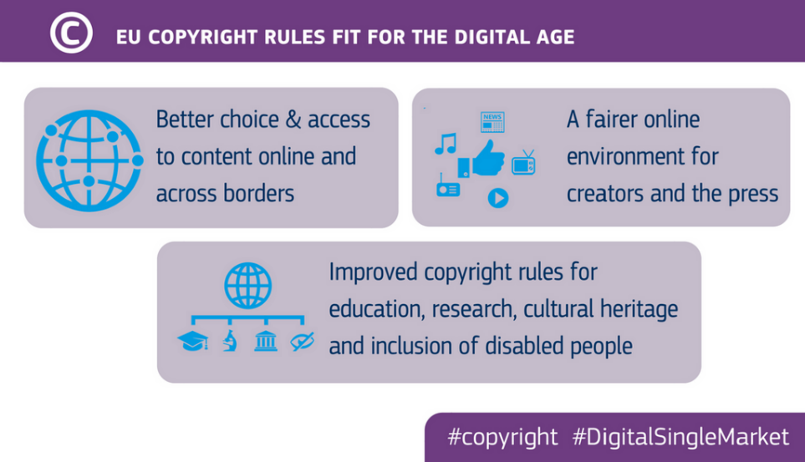
The European landscape of research data and data for research

Slide 19
Turning FAIR into reality
Report and Action Plan: take a holistic approach to lay out what needs to be done to make FAIR a reality, in general and for EOSC
Key areas: concepts for FAIR, the FAIR data culture, the FAIR data ecosystem, skills, incentives and metrics, investment and sustainability
Recommendations and actions: 27 recommendations, structured by these topics, are supported by actions for stakeholders
Source: EC Expert Group

Slide 20
Research data in H2020 (1/2)
Not so much a pilot any more
By default in, unless exception in the Work Programme or excluded instrument (e.g. co-fund, prizes, SME instrument phase 1, ERC proof of concept…)
Not that focused on openness of data only
Research Data Management as a standard practice through Data Management Plans (required as early deliverable)
Fully eligible costs for open access during duration of project
Underlying data, and ‘any other data’ defined by the beneficiaries
Opt-out at any stage (just give reasons why, for our understanding)
“As open as possible, as closed as necessary”

Slide 21
Research data in H2020 (2/2)
What’s up?
2014-2016: participation of 68% (core areas) and 9% (opt-in)
2017 (after extension of the scope): participation of 62% (whole H2020)
Main reasons for opt out: IPR and data protection
What next?
Need for new figures and overall analysis
Procurement (externalisation of the analysis) currently debated for end of 2019
Pointer: ORD uptake in H2020 in the EU Open Data Portal

Slide 22
The evolution of the EU funding programmes for R&I
2021
FP7
OA Pilot
Deposit and open access
Horizon 2020
OA Mandatory
Deposit and open access
& ORD/DMP Pilot
Horizon 2020
OA Mandatory
Deposit and open access
& ORD/DMP by default
(opt-out)
2017
Horizon Europe
OA Mandatory
Deposit and open access
DMP in line with FAIR Mandatory
ORD by default (exceptions)
& Open Science embedded
2014
2008

Slide 23
Open Science in Horizon Europe
Horizon Europe goes beyond open access (publications & data) to embrace and incentivize open science as modus operandi
1. Clarifies and strengthens the open access obligations while empowering authors of scientific publications
2. Sets obligations towards FAIR and open data sharing, and data management, while complying with IPR rules and exploitation obligations
3. Encourages open access to other research output
4. Promotes compliance with open science principles through a combination of obligations and incentives
5. Implements sanctions for those beneficiaries that repeatedly and consistently fail to provide the required open access, requiring institutions to assume responsibility for their intellectual output
6. Introduces the use of new generation metrics for better assessing the impact of research output and the engagement in open science

Slide 24
Possible scenario for incorporation of Plan S principles in Horizon Europe
Open access via repositories kept but made immediate
Embargoes not accepted any longer
Copyright retention and open license asked for
Copyright retention already in the HE Regulation
Open license to be required (in line with new standard licence adopted by the EC for its own information production)
Publication in hybrid journals allowed
However, costs not to be eligible

Slide 25
Proposals for research data in Horizon Europe
Mandatory Data Management Plan
When there is research data generated, collected, re-used…
Open by default
Unless it cannot be (exceptions will apply- we will not use the term ‘opt-out’ any more)
Open access/data management disambiguated
Different from current situation
Use of European Open Science Cloud required
In some Work Programmes

Slide 26
Thank you!
Mail: RTD-open-access@ec.europa.eu
Web: ec.europa.eu/research/openscience/
This work is licensed under a Creative Commons Attribution 4.0 International License and illustrations are in the public domain (otherwise the origin is mentioned)

